Slide 1
Identifying Similar Design Decisions
Prateek Bagrecha, Garching, 11.08.2017

Slide 2
Agenda
Introduction
Motivation
Research Questions
Methodology: Derived Meta Model of ADDs
Methodology: Where do parameters lie ?
Methodology: Decision Compare Model
Comparing Parameters: An Example
Next Steps

Slide 3

Introduction: A Decision
Issues | SPARK-8321
Opened By
Description | Authorization Support(on all operations not only DDL) in Spark Sql
Concepts | Apache, SQL, authentication
Keywords | Spark, operations, Support, Authorization
Components | SQL
Issue Type | Improvement
Created | 12/Jun/15 03:34
Resolved | 16/Jun/16 08:22

Slide 4

Introduction: Another Decision
Issues | SPARK-19625
Opened by
Description | Authorization Support(on all operations not only DDL) in Spark Sql version 2.1.0
Concepts | Apache, SQL, authentication
Keywords | Spark, operations, Support, Authorization
Components | Spark Core, SQL
Issue Type | Improvement
Created | 16/Feb/17 09:36
Resolved | 24/Mar/17 01:21

Slide 5
Introduction: Two Decisions
Issues | SPARK-8321 | SPARK-19625
Description | Authorization Support(on all operations not only DDL) in Spark Sql | Authorization Support(on all operations not only DDL) in Spark Sql version 2.1.0
Concepts | Apache, SQL, authentication | Apache, SQL, authentication
Keywords | Spark, operations, Support, Authorization | Spark, operations, Support, Authorization
Components | SQL | Spark Core, SQL
Issue Type | Improvement | Improvement
Created | 12/Jun/15 03:34 | 16/Feb/17 09:36
Resolved | 16/Jun/16 08:22 | 24/Mar/17 01:21

Slide 6
Introduction: Two Decisions
Helpful if second reporter could have been informed about the similar design decision made in past
Reduced time to analzye
Reduced time to resolution
Reduced time to feedback
Need for identifying similarities in design decisions.
Given a new design decision, search the knowledge base for similar earlier made design decisions.

Slide 7
Identifying similarities in design decisions
Motivation
Documentation - specifying constraints on similar design decisions
Communication - visual representation of related design decisions
Complexity - Inferring the complexity for addressing similar design decisions
Research Questions
How to identify similar design decisions?
What are the context parameters that needs to be considered?
Which similarity measures are most efficient for comparing context parameters?

Slide 8
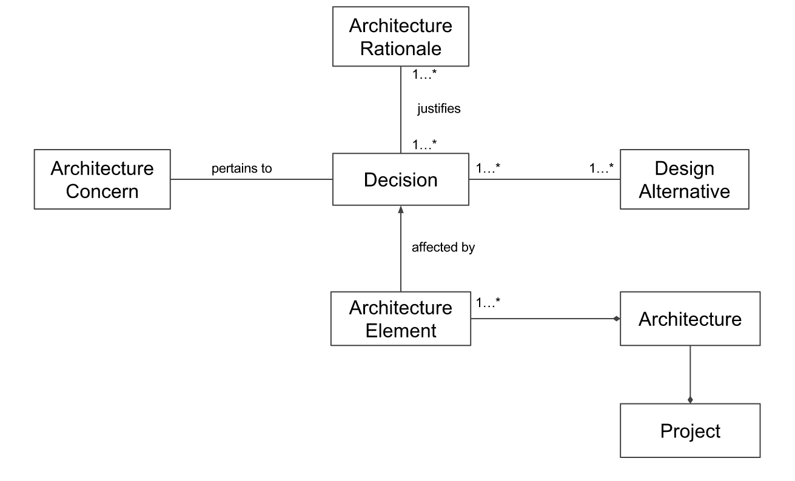
Methodology: Derived Meta Model

Slide 9
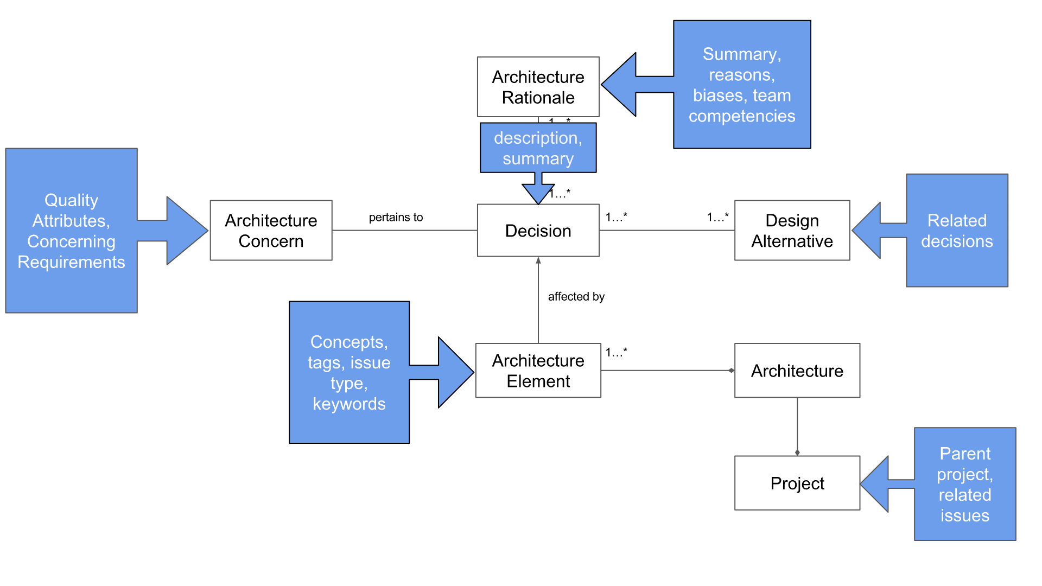
Methodology: Where do parameters lie ?

Slide 10
Methodology: Comparison Model
Given a new design decision
Get all parameters from the decision
Calculate similarity
Show results
Goal: Analyse alternatives to performing text similarity
Syntactic similarity
Machine learning algorithms for unsupervised clustering
Semantic similarity – wordnet based, NLP based (using tag tress)

Slide 11
Comparing Parameters: An Example
Issues | SPARK-8321 | SPARK-19625
Description | Authorization Support(on all operations not only DDL) in Spark Sql | Authorization Support(on all operations not only DDL) in Spark Sql version 2.1.0 | Cosine Similarity 91.29%
Concepts | Apache, SQL, authentication | Apache, SQL, authentication | Dice Coefficient 100%
Keywords | Spark, operations, Support, Authorization | Spark, operations, Support, Authorization | Dice Coefficient 100%
Components | SQL | Spark Core, SQL | Dice Coefficient 50%
Issue Type | Improvement | Improvement
Created | 12/Jun/15 03:34 | 16/Feb/17 09:36
Resolved | 16/Jun/16 08:22 | 24/Mar/17 01:21

Slide 12
Next Steps
Initial Steps
  Gathering data sets
  Split data sets: training and testing
Prepare Analytical Model
  Decide on the parameters to consider
  Compare parameters - Compare decisions
Simulate
  Provide Web Interface for searching and comparing design decisions
Validate
  Evaluate the model

Slide 13
Thank you

